Slide 1


KU-LG Chem iPBL
환경 이슈 해결 가능한
비할로겐계 난연 소재 제안
중간 성과 보고회
2023.01.04
임가영 곽다인 필감성

Slide 2
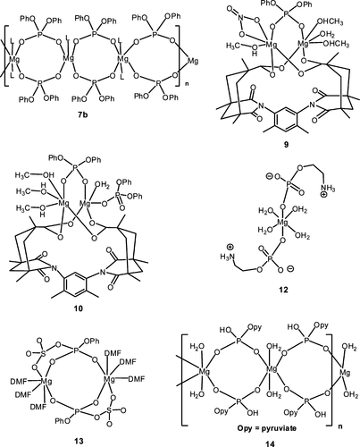
1. Research
Synthesis #1
RT, Ar
+
MgBr₂
DCM (anhydrous)
+
MCl₂
Aqueous solution
M=Zn²⁺, Mg²⁺ or Mn²⁺
Notes:
Almost colorless crystals of the title compounds were grown from aqueous solutions containing a 1:1 molar ratio mixture of MCl2 (where M=Zn2+, Mg2+ or Mn2+) and phosphoenolpyruvic acid. Dm measured by flotation in CCl4/C2H4Br2 mixture. Kuma KM4 diffractometer
Ref. Lis, T. Acta Crystallogr. 1992, C48, 424.

Slide 3
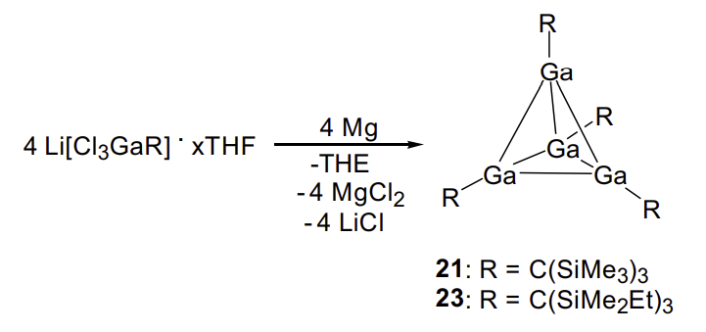
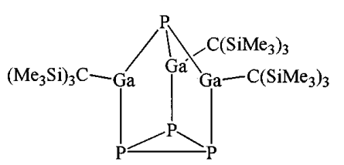
1. Research
Synthesis #2
P₄
Hexane, refluxed 14 h
ZnO, Phosphonic acid
EA, Reflux 14 h

Slide 4
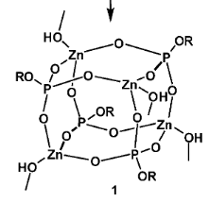
1. Research
Synthesis #3
MeOH
Mild condition
Simple synthesis
+
[Procedure]
Zn(OAc)₂*2H₂O (219 mg, 1 mmol) and dippH₂ (diisopropylphenyl ester of phosphoric acid) (258 mg, 1mmol) were mixed in methanol (30 mL) and warmed to get a clear solution. The reaction mixture was filtered, concentrated, and left overnight to yield a precipitate of 1 (0.3 g, 85%)
[Characterization]
¹H NMR ([D₆]acetone, 300 MHz):d=7.02 (s, 12H; Ar), 3.77 (septet,³J (H,H)=6.9 Hz, 8H;iPr-CH), 3.65(br, 4H; OH), 3.30 (s, 12H; CH3), 1.11 ppm (d, 48H;iPr-CH3);³¹P NMR([D₆]acetone, 121 MHz):d=4.5 ppm;
[Properties]
M.p > 275 ℃, TGA: Temperature range (%wt loss) : 10-206℃ (9.5), 206-600℃ (45.1)
Chem. Eur. J. 2010,16, 994 – 1009

Slide 5
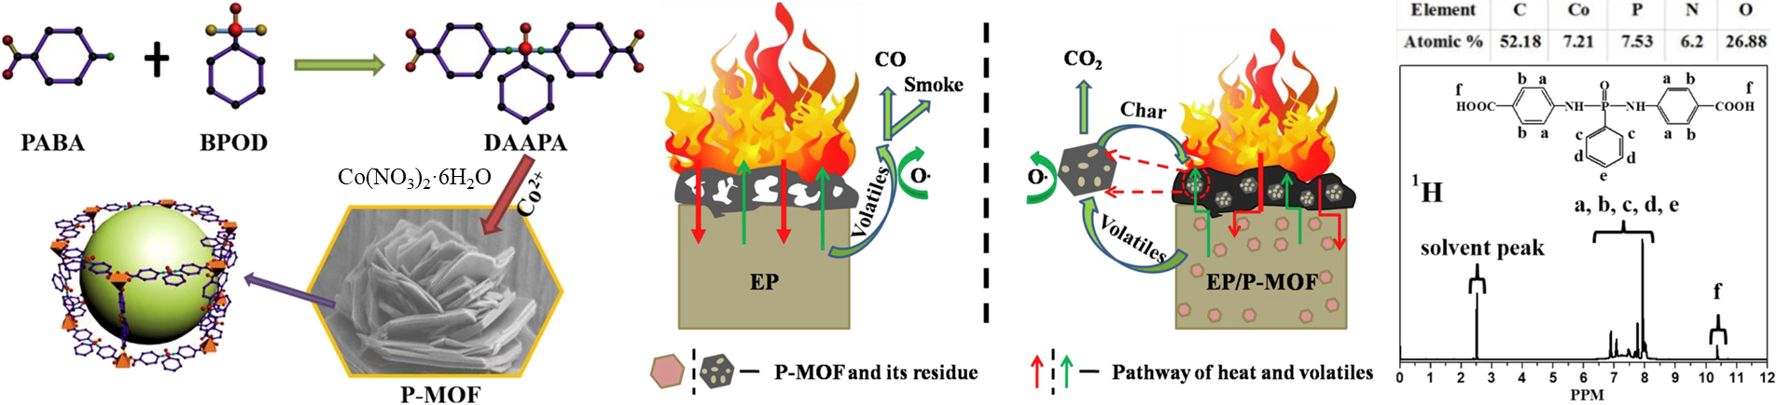
1. Research
Synthesis #4
[Procedure]
DAAPA : BPOD was added into PABA (molar ratio 2:1), dispersed in 1, 4-dioxane, dropwise at 80℃ under nitrogen atmosphere in 1,4-dioxane. Keep reaction at 80℃ for 0.5 h and cool down to room temperature. White precipitate was collected, washed by acetone, and dried at 50℃ overnight.
P-MOF : 0.1 M Co(NO₃)₂·6H₂O methanol solution (10 mL) was poured into DAAPA (0.002 mol) dispersed 60 mL MeOH. The solution was transformed into 80mL autoclave and keep 160℃ for 12 h before cooling to RT.
[Characterization]
¹H NMR (solvent peak 2.5 ppm, benzene : 6.75-8.25 ppm, carbonyl groups : 10.5 ppm
[Properties]
TGA: Temperature range (%wt loss) : 0-399℃ (5)
Y. Hou et al. / Composites Science and Technology 152 (2017) 231-242
Notes:
BPOD : Dichlorophenylphosphine oxide
PABA : 4-aminobenzoic acid
DAAPA : Di (para-aminobenzoic acid) phenyl phosphate amide
MeOH : anhydrous methanol
Co(NO₃)₂·6H₂O : cobalt nitrate hexahydrate
DDM : diaminodiphenylmethane

Slide 6
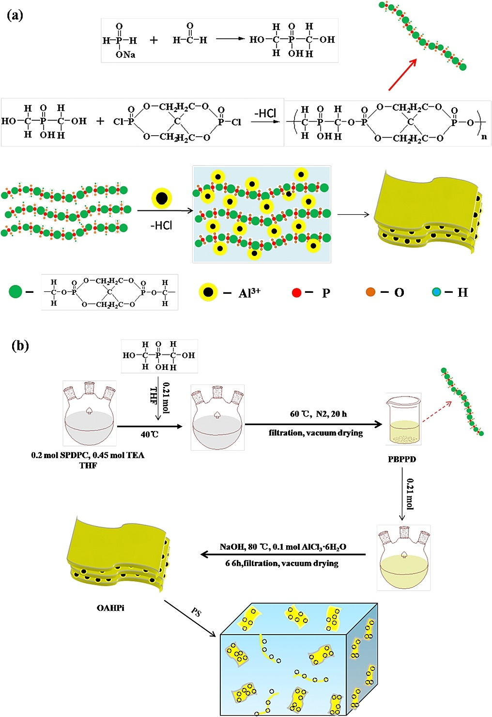
1. Research
Synthesis #5
[Procedure]
Sodium hypophosphite hydrate (0.2 mol) was dissolved in 100 mL distilled water with stirring at 80℃ with an assistance of reflux unit. POM (0.25 mol) was slowly added into the solution. Simultaneously, moderate HCl solution was introduced into reaction system as catalyst. This procedure was performed under a nitrogen atmosphere at 80 C for 8 h. The white viscous liquid was obtained after removing the solvent, which was dihydroxy alkylate hypophosphorous acid (DAHA).
[Characterization]
¹H NMR (-OH group of phosphonic acid : 2.7 ppm, -CH2- group in helical structure : 3.9 ppm, alkyl near phosphorus : 4.7 ppm
[Properties]
TGA: Temperature range (%wt loss) : 0-362℃ (10)
Y. Hou et al. / Materials Chemistry and Physics 196 (2017) 109-117

Slide 7
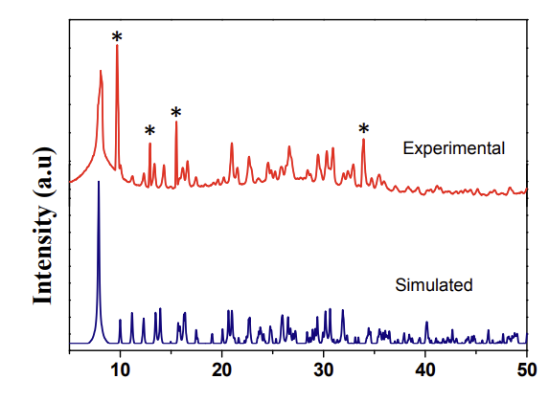
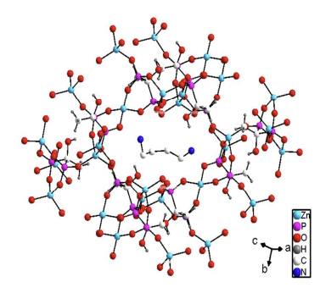
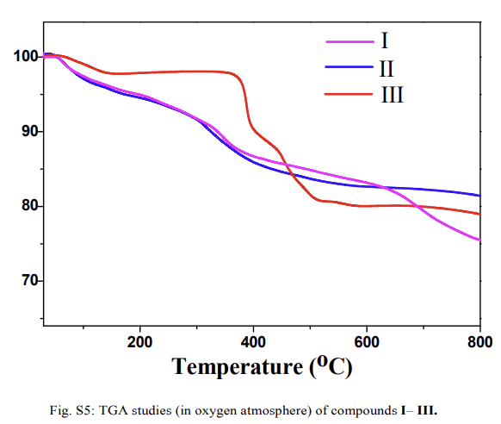
1. Research
[Characterization]
Synthesis #6
+
ZnSO₄·H₂O
[Procedure]
ZnSO4·H2O (0.179 g, 1 mmol), hedpH4 (0.28 mL, 2 mmol), and DAB with the molar ratio of 1:2:2. The resultant solution was mixed for 1 h at room temperature, sealed in a 20 mL Teflon-lined stainless steel autoclave, and heated at 160 °C for 72 h under autogenous pressure to obtain colorless three-dimensional structure.
[Properties]
TGA: Temperature range (%wt loss) : 30-150℃ (2.5), 350-600℃(21)
Cryst. Growth Des. 2017, 17, 5620−5624
Notes:
DAB : 1,4-diaminobutane

Slide 8
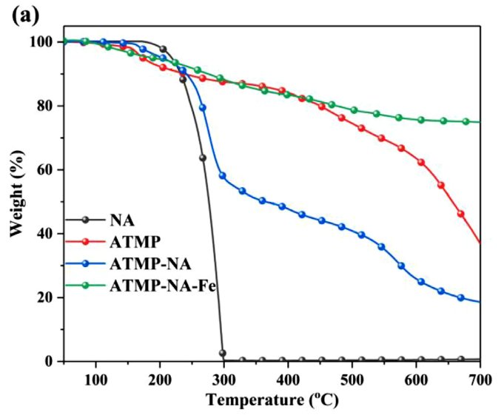
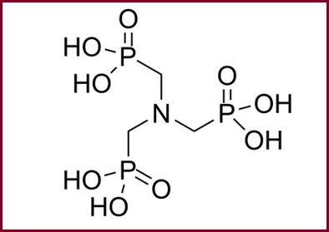
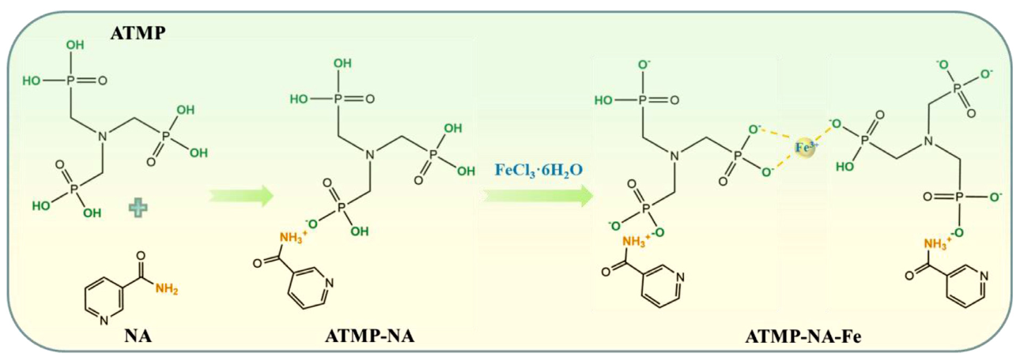
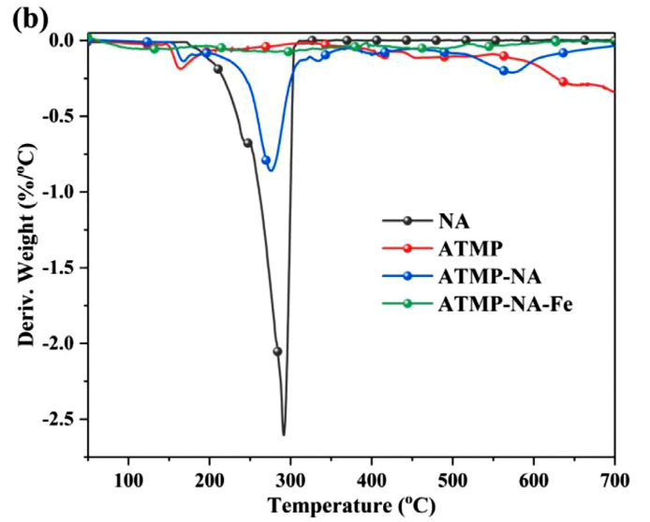
1. Research
Synthesis #7
Amino trimethylene phosphonic acid (ATMP)
[Simple procedure]
9.88 g of ATMP and 400 mL of deionized water were added into a 1 L beaker and stirred to form a dilute solution with a pH value of 1. 36.95 g of NA and 27.05 g of FeCl₃•6H₂O were dis-solved in 200 mL of deionized water to form their solutions. Then, the NA solution was added to ATMP solution and stirred continuously for 10 min to obtain ATMP-NA solution. Whereafter, whenFeCl3•6H2O solution was slowly added into the above mixed solution, the white precipitate was produced rapidly, and the reaction was continued for 10 min under constant stirring. The concentrations of Fe3+ and ATMP-NA were 0.125 mol/L in the mixed solution, each. The obtained precipitate (ATMP-NA-Fe) was centrifuged and washed with 600 mL of deionized water by two cycles. Finally, it was dried at 80 °C for 12 h and ground into a powder
[Properties]
The initial decomposition temperature (T_{initial} , the temperature at 5% mass loss) :NA 219 °C, ATMP 174 °C, ATMP-NA-Fe 190°C [lose of absorbed water]
From the DTG curve, it is worth noting that the maximum decomposition rate of ATMP-NA- Fe is lower than those of ATMP and ATMP-NA. [Fe3+ is beneficial to the carbonization of ATMP-NA, thus improving its thermal stability at high temperature.]
Notes:
Zhan, Y., Wu, X., Wang, S., Yuan, B., Fang, Q., Shang, S., ... & Chen, G. (2021). Synthesis of a bio-based flame retardant via a facile strategy and its synergistic effect with ammonium polyphosphate on the flame retardancy of polylactic acid. Polymer Degradation and Stability, 191, 109684.

Slide 9
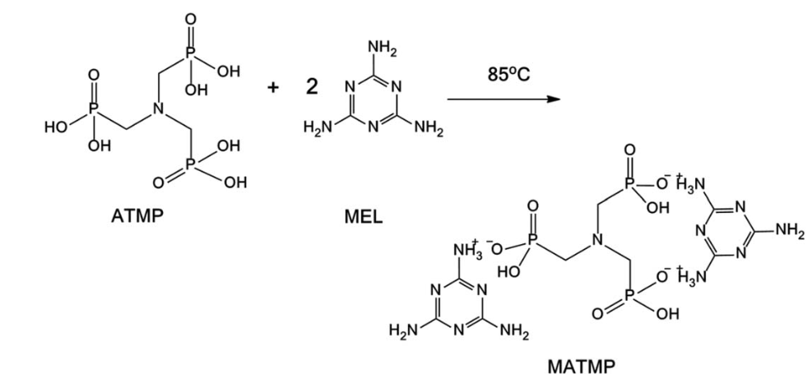
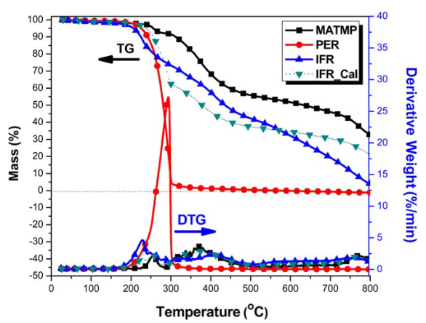
1. Research
Synthesis #8
Amino trimethylene phosphonic acid (ATMP)
pentaerythritol (PER)
[Procedure]
intumescent flame retardants (IFR)
ATMP was dried at 808 °C for 8 h before use. Next,30.0 g (0.24 mol) of MEL and 300 mL of deionized water were added into a 500 mL four-necked flask equipped with a mechanical stirrer, thermometer, and condenser. Under vigorous stirring, this suspension was heated to 858 °C by a thermostatic water bath. Then 35.7 g (0.12 mol) of ATMP, after being dissolved in 100 mL of deionized water, was dropwise added into the MEL suspension within 1 h. The reaction was kept for 3h at 858 °C. Then it was filtered, washed by hot deionized water several times, and dried at 808 °C overnight. The raw product was heated at 200 °C for 2h.The obtained MATMP was ground and screened through 200 mesh. The product yield was 87.0%
[Properties]
MATMP has water resistance and good thermal stability; residual chars of 68.4, 51.7, and 32.5 wt % are left at 400, 600, and 800 °C
Notes:
MLAGao, Shang, and Gousheng Liu. "Synthesis of amino trimethylene phosphonic acid melamine salt and its application in flame‐retarded polypropylene." Journal of Applied Polymer Science 135.22 (2018): 46274

Slide 10
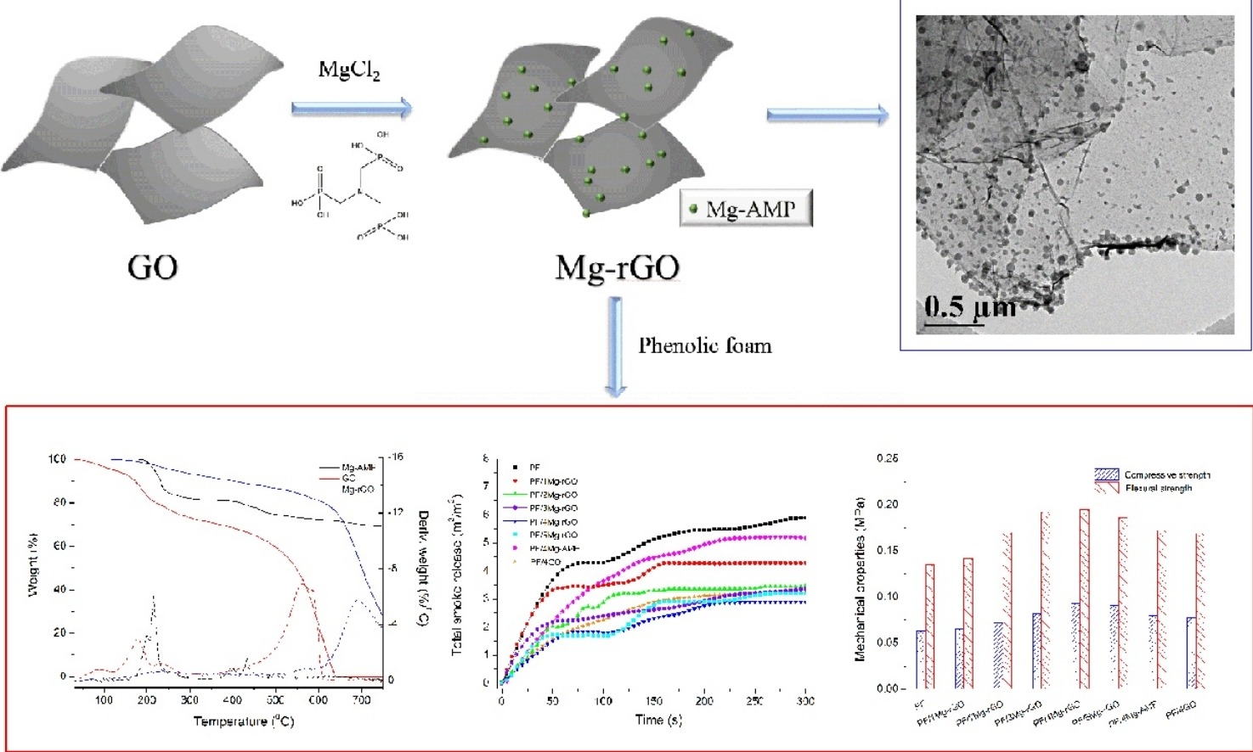
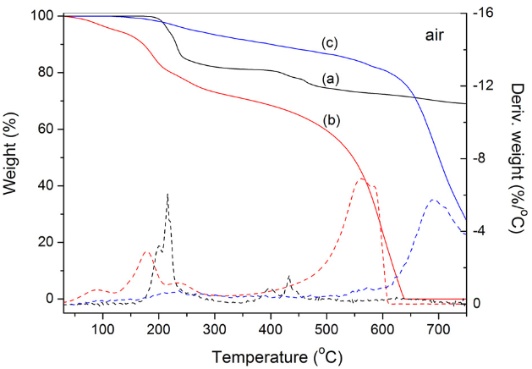
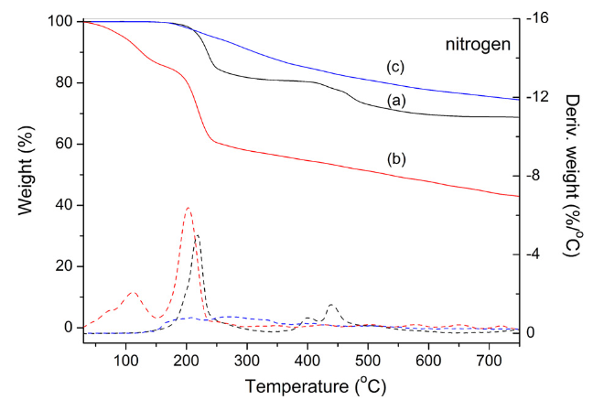
1. Research
Synthesis #9
Amino trimethylene phosphonic acid (ATMP)
TGA and DTG curves of (a) Mg-AMP, (b) GO, and (c) Mg-rGO under air and nitrogen atmosphere.
[Procedure]
Graphene oxide (GO) was prepared by the modified Hummersmethod. MgCl2•6H2O (1.2 g) and GO (300 mg) were first sus-pended in 100 ml deionized water in a 250 ml three-neck bottle fittedwith a mechanical stirrer, and the pH of the solution was adjusted to 1.0with the addition of hydrochloric acid. Subsequently, AMP (3.6 g) was added dropwise to the vigorous reaction mixture. Then, the obtained system was refluxed at 100 °C for 36 h. Afterwards, the reaction mixture was cooled to room temperature, and the solid products were separated by centrifugation from the mixture, washed with deionized water and dried in a vacuum oven at 80 °C for 48 h.
[Properties]
GO functionalization and reduction with Mg-AMP enhanced GO’s thermal stability, and the Tmax of Mg-rGO increased by as much as 88.1 °C
Notes:
Liu, Lei, and Zhengzhou Wang. "Facile synthesis of a novel magnesium amino-tris-(methylenephosphonate)-reduced graphene oxide hybrid and its high performance in mechanical strength, thermal stability, smoke suppression and flame retardancy in phenolic foam." Journal of hazardous materials 357 (2018): 89-99

Slide 11
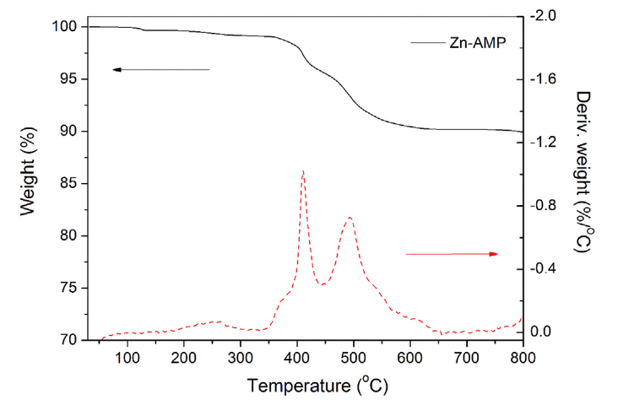
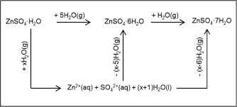
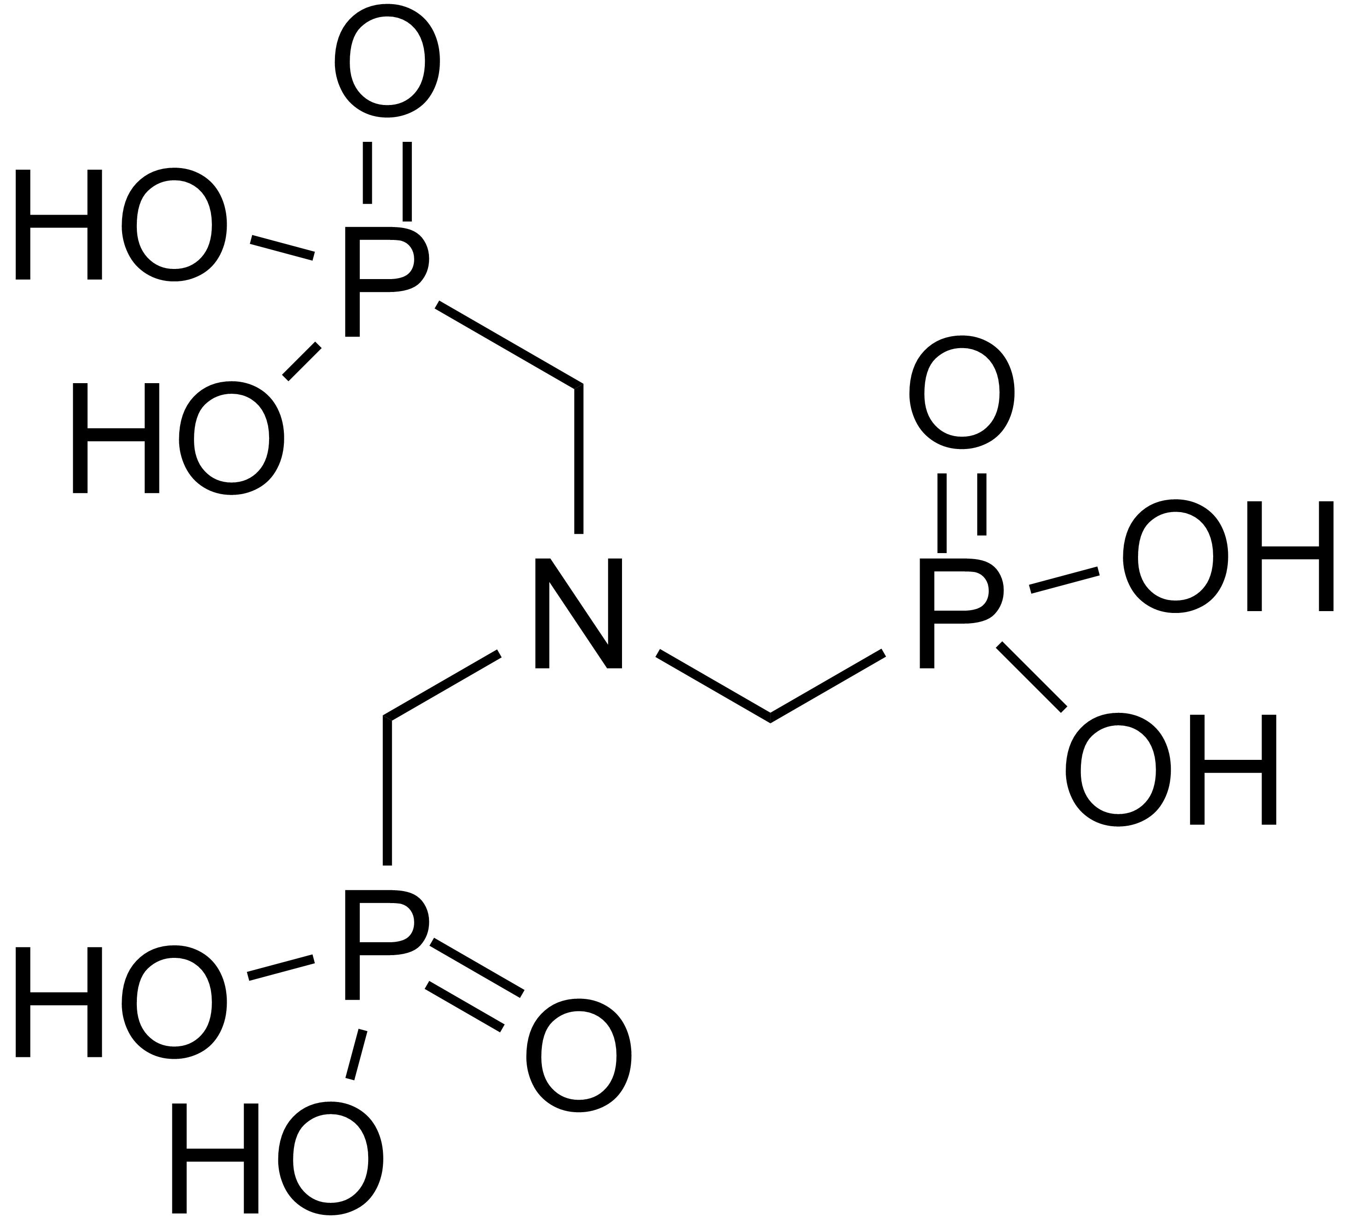
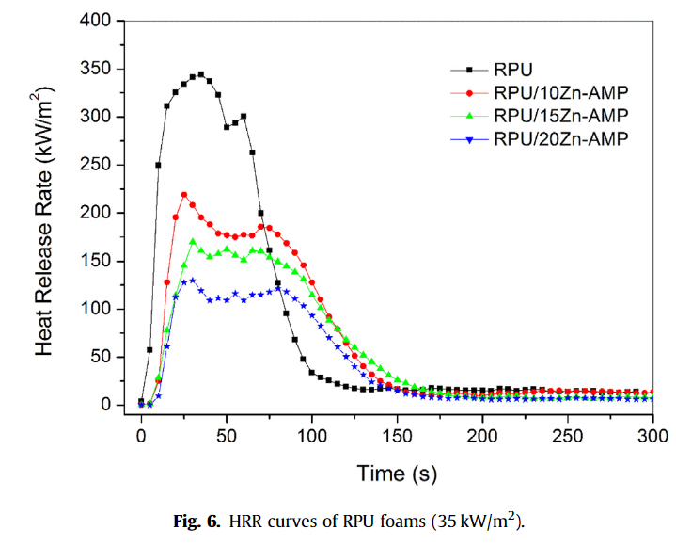
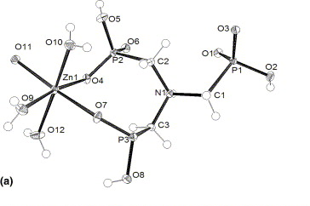
1. Research
Synthesis #10
Amino trimethylene phosphonic acid (ATMP)
[Procedure]
ZnSO4 7H2O (43.1 g, 0.15 mol) and 350 ml deionized water were loaded into a 1000 ml three-necked round bottom flask equipped with a mechanical stirrer, and the pH value was adjusted to 1.0 with sulfuric acid solution. After that, a 50% solution of 44.9 g AMP(0.15 mol) in deionized water was then added dropwise to the mixture to react for 24 h under ambient conditions. The resulting precipitate was filtered and washed with deionized water followed by drying at 100 C for 48 h in a vacuum oven.
[Properties]
Flammability of RPU/Zn-AMP foam was significantly reduced and the LOI of RPU/20Zn-AMP increased from the 19% of untreated RPU foam to 25%. 20 wt% Zn-AMP significantly increased RPU foam's thermal stability at high temperatures.
Notes:
zinc amino-tris-(methylenephosphonate)
Liu, Lei, and Zhengzhou Wang. "High performance nano-zinc amino-tris-(methylenephosphonate) in rigid polyurethane foam with improved mechanical strength, thermal stability and flame retardancy." Polymer Degradation and Stability 154 (2018): 62-72.

Slide 12
Thank you for listening
Any questions?

