Slide 1

KU-LG Chem iPBL
Multi nuclear type supramolecular structure
자료조사
2nd Meeting 2022.11.25

Slide 2
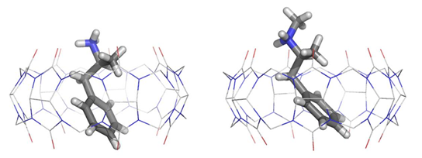
1. 특허 회피 전략
Colorless
Metal 종류
Ga, Zn
Chelation
Highly P content
Solubility
Toxicity
Metal 종류
Bi, Ga
Supramolecular chemistry (초분자 화학) :
분자 간 결합에 의해 형성되는 molecule assembly로 molecular recognition, self-assembly, host-guest system 등이 supramolecular chemistry의 원리라고 할 수 있다.
Supramolecule
Multi-nuclei type

Slide 3
2. Metal 종류 및 특징
Metal | Oxidative number | Color | toxicity
Zn (Zinc) | +2, +3, +4 | bluish silver | O
Ga (Gallium) | +3 | silvery-white | O
Sb (Antimony) | −3, +3, +5 | silvery lustrous gray | O
Bi (Bismuth) | +3, +5 | brownish silver | X
Fe (Iron) | +1, +2, +3 | silvery-gray | O
Sn (tin) | +2, +4 | silvery | O

Slide 4
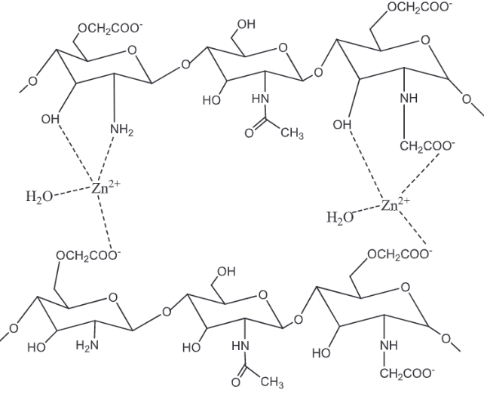
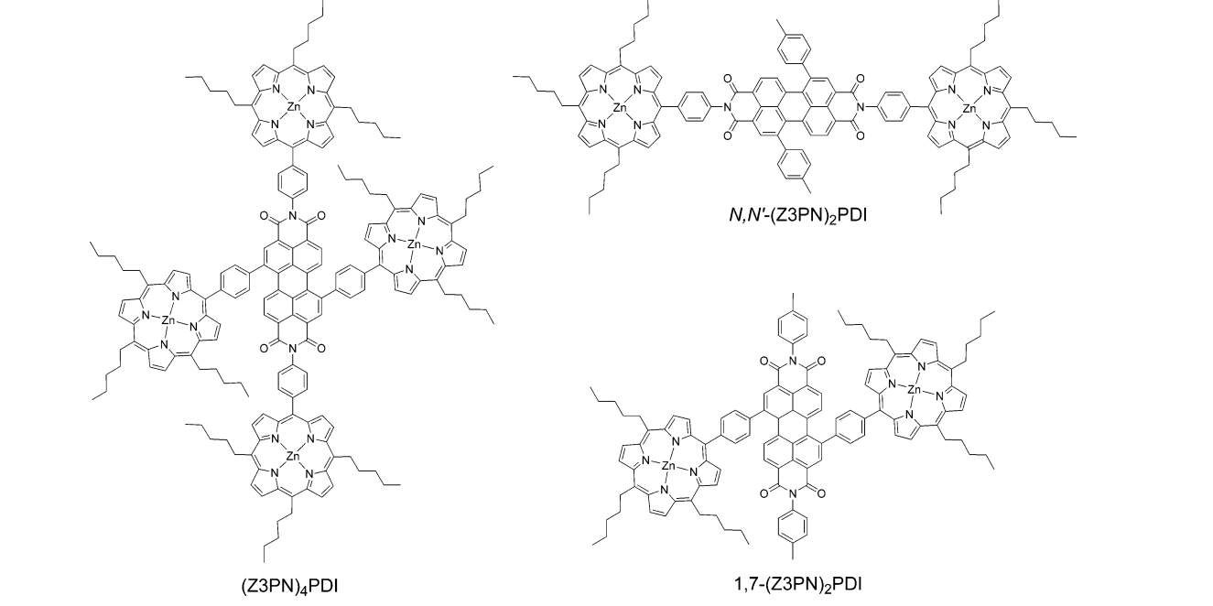
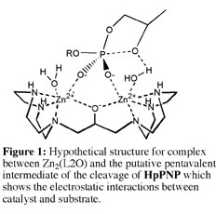
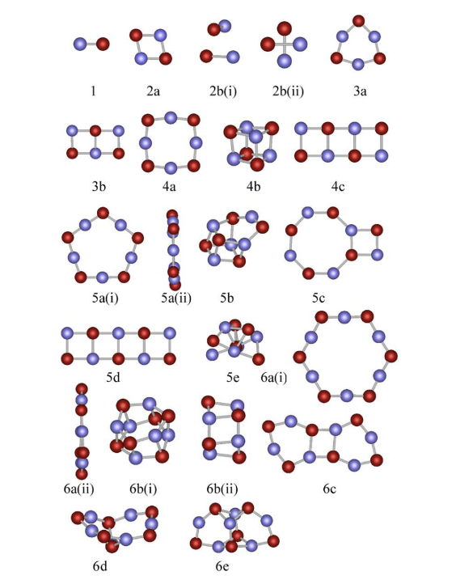
18
3. Metal의 종류와 결합
Zinc
J. AM. CHEM. SOC. 2007, 129, 3173-3181
/ International Journal of Biological Macromolecules 114 (2018) 1233–1239
A. Jain et al. / Computational Materials Science 36 (2006) 258–262 261

Slide 5
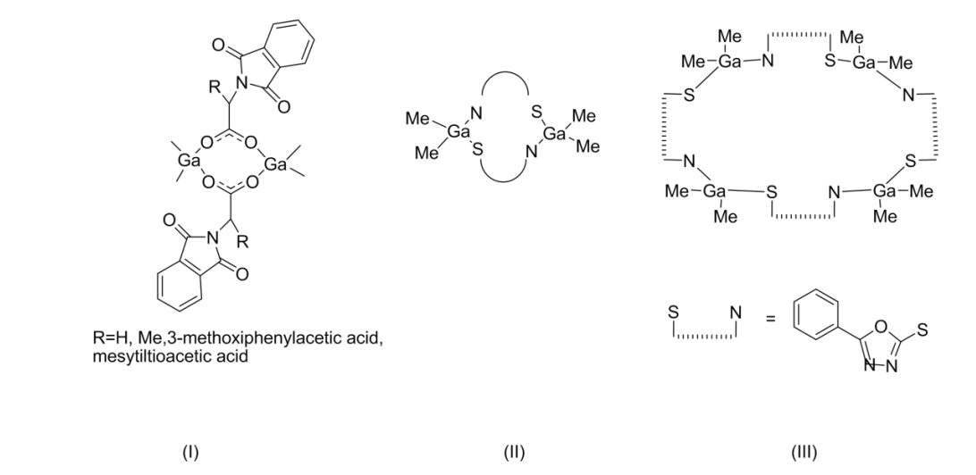
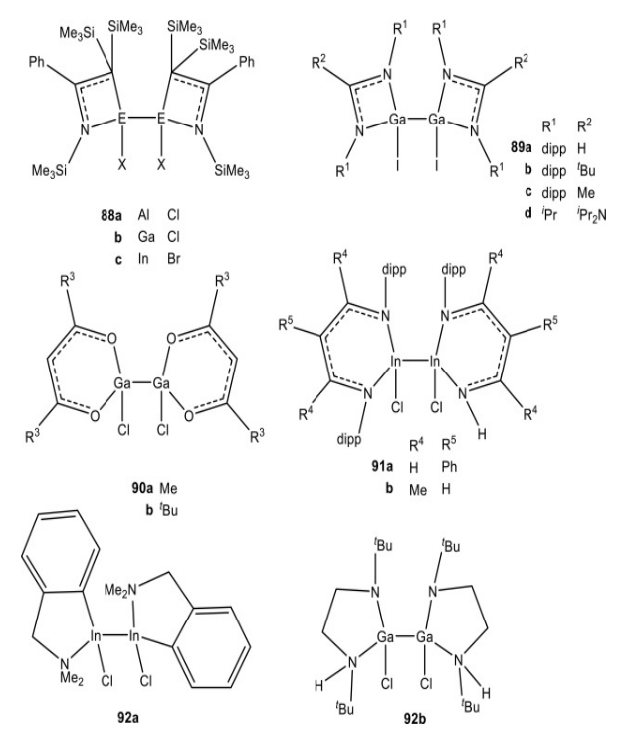
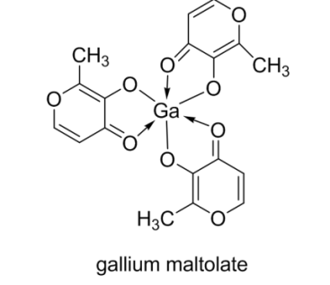
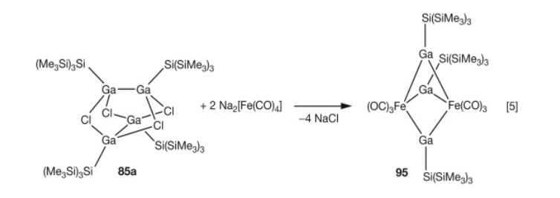
18
3. Metal의 종류와 결합
Gallium
Notes:
Gallium Compounds - an overview | ScienceDirect Topics

Slide 6
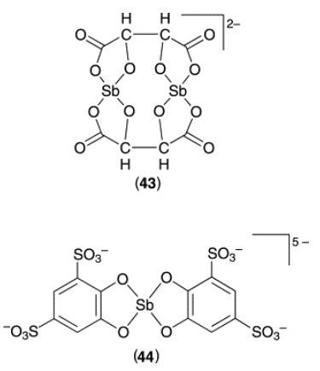
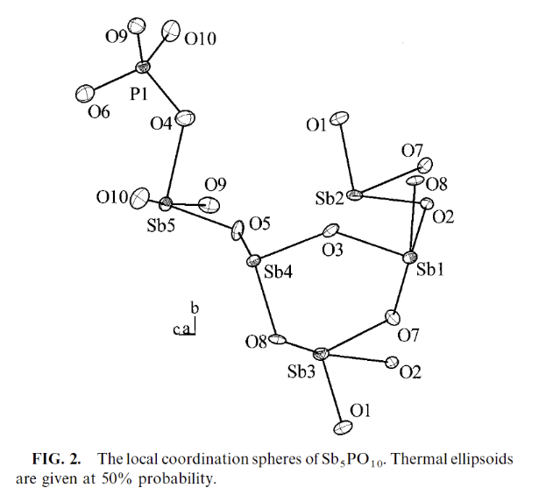
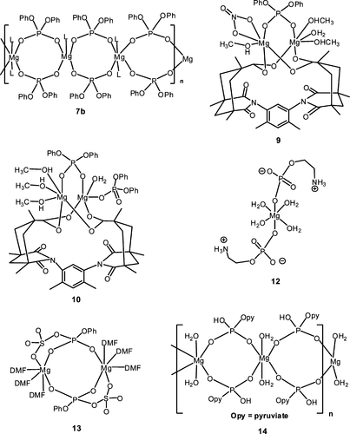
3. Metal의 종류와 결합
Antimony
Zinc
Tin
Notes:
2008, 108, 9, 3549–3655, New J. Chem., 2018, 42, 1655.

Slide 7
18
4. Next Plan
Phosphate ligand
Commercially Available
Ligand
Search
Synthesis

Slide 8
Thank you for listening
Any questions?

