Slide 1


KU-LG Chem iPBL
환경 이슈 해결 가능한
비할로겐계 난연 소재 제안
중간 성과 보고회
2022.12.16
임가영 곽다인 필감성

Slide 2
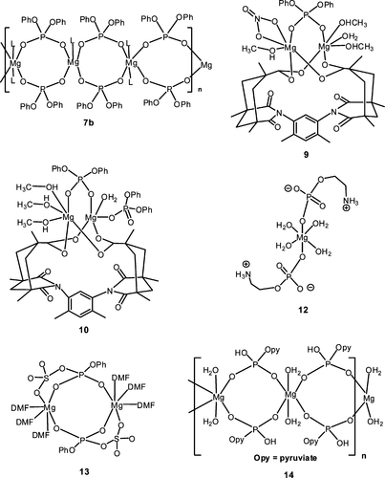
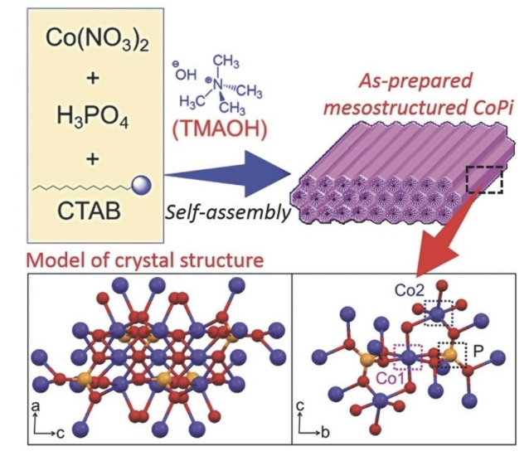
1. Research
Synthesis
RT, Ar
+
MgBr₂
DCM (anhydrous)
+
MCl₂
Aqueous solution
M=Zn2+, Mg2+ or Mn2+
Notes:
Almost colorless crystals of the title compounds were grown from aqueous solutions containing a 1:1 molar ratio mixture of MCl2 (where M=Zn2+, Mg2+ or Mn2+) and phosphoenolpyruvic acid. Dm measured by flotation in CCl4/C2H4Br2 mixture. Kuma KM4 diffractometer
Ref. Lis, T. Acta Crystallogr. 1992, C48, 424.

Slide 3
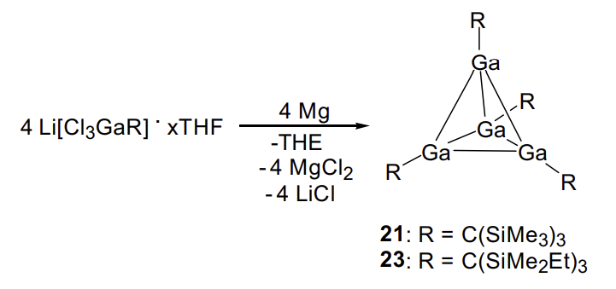
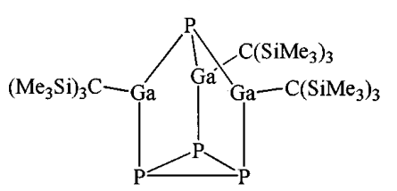
1. Research
Synthesis
P₄
Hexane, refluxed 14 h
ZnO, Phosphonic acid
EA, Reflux 14 h

Slide 4
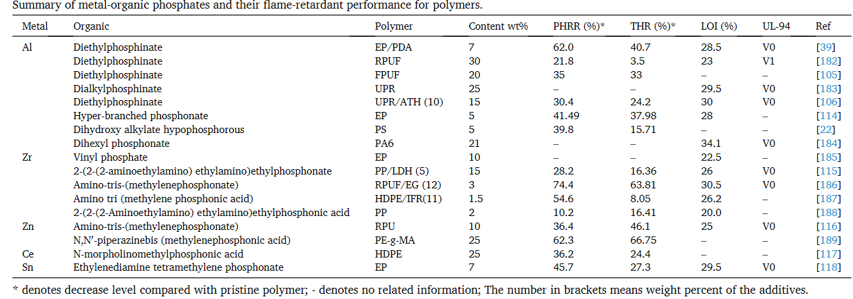
3
1. Research
Metal의 종류와 결합
Metal organic frameworks (MOFs)
Composites Part B: Engineering 221 (2021): 109014.
Notes:
2008, 108, 9, 3549–3655, New J. Chem., 2018, 42, 1655.

Slide 5
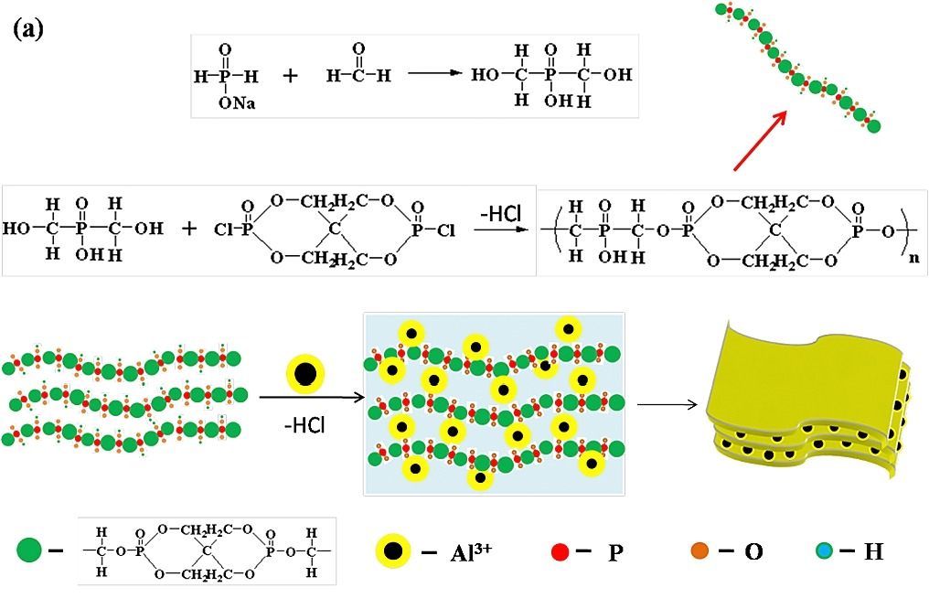
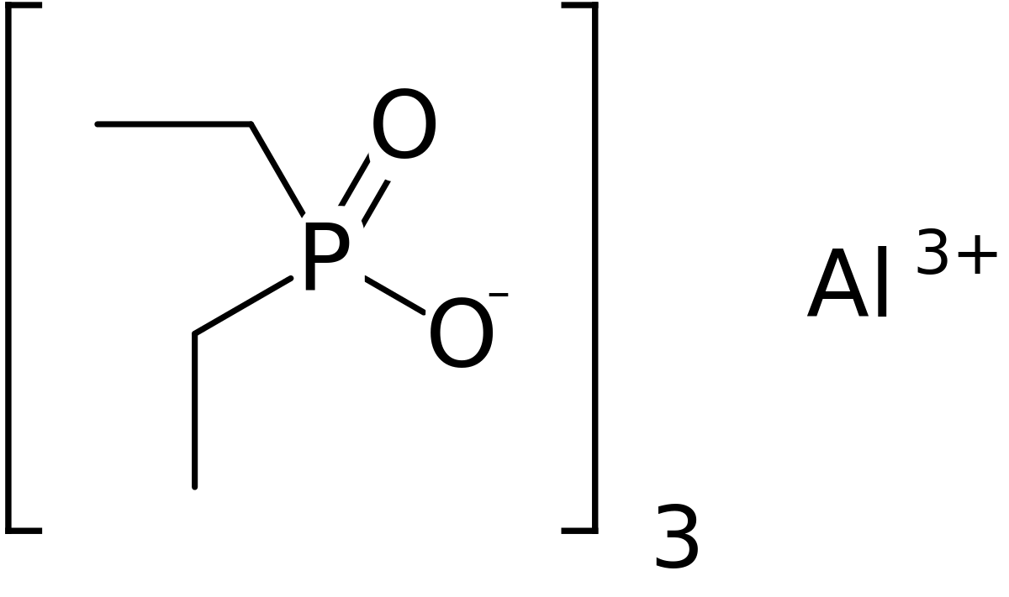
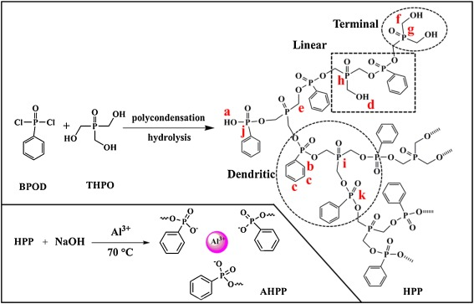
3
1. Research
Metal의 종류와 결합
Metal organic frameworks (MOFs)
Al
High-efficiency aluminum diethylphosphinate (ADP)
A layer organic aluminum phosphinate (OAHPi)
Hyper-branched aluminum phosphonate (AHPP)
Journal of hazardous materials 381 (2020): 121233.
Materials Chemistry and Physics 196 (2017): 109-117.
Composites Part B: Engineering 221 (2021): 109014.

Slide 6
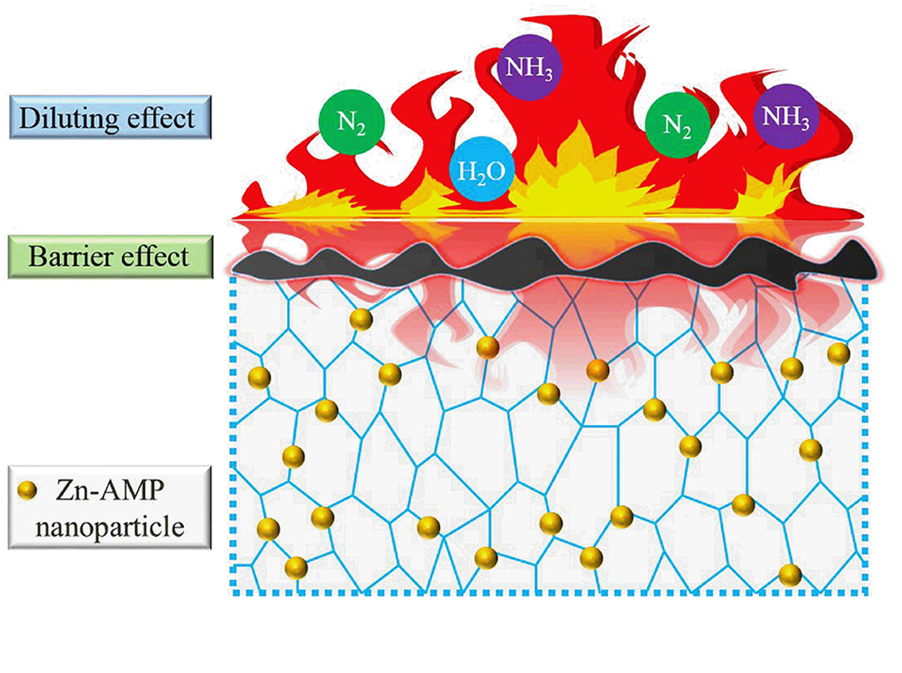
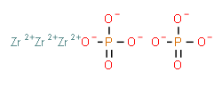
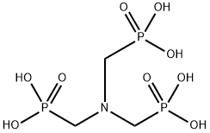
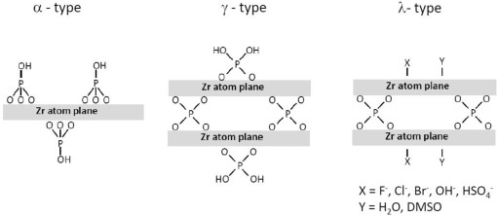
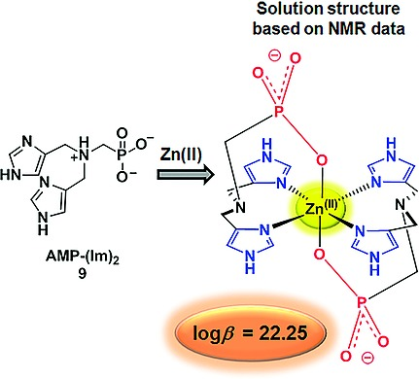
3
1. Research
Metal의 종류와 결합
Metal organic frameworks (MOFs)
Zr
Zirconium phosphate
Zinc amino-tris-(methylenephosphonate) (Zn-AMP)
Layered zirconium phosphates and phosphonates
Composites Part B: Engineering 221 (2021): 109014.
European Journal of Inorganic Chemistry 2017.23 (2017): 2955-2967.
Solid State Ionics 336 (2019): 1-10.

Slide 7
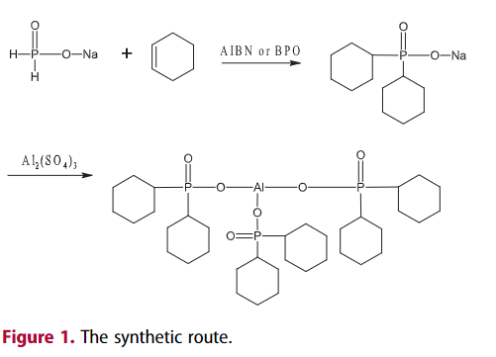
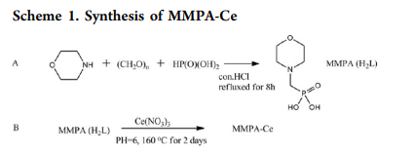
2. Ligand

Slide 8
Thank you for listening
Any questions?

